Slide 1
Simplifying Boolean Equations
Example 3:
Y = A’BC + A’ Recall: A’ = A

Slide 2
Simplifying Boolean Equations
Example 3:
Y = A’BC + A’ Recall: A’ = A
= A’ T9’ Covering: X + XY = X
or
= A’(BC + 1) T8: Distributivity
= A’(1) T2’: Null Element
= A’ T1: Identity

Slide 3
Simplifying Boolean Equations
Example 4:
Y = AB’C + ABC + A’BC

Slide 4
Simplifying Boolean Equations
Example 4:
Y = AB’C + ABC + A’BC
= AB’C + ABC + ABC + A’BC T3’: Idempotency
= (AB’C+ABC) + (ABC+A’BC) T7’: Associativity
= AC + BC T10: Combining

Slide 5
Simplifying Boolean Equations
Example 5:
Y = AB + BC +B’D’ + AC’D’

Slide 6
Simplifying Boolean Equations
Example 5:
Y = AB + BC +B’D’ + AC’D’

Slide 7
Simplifying Boolean Equations
Example 5:
Y = AB + BC +B’D’ + AC’D’
Y = AB + BC + B’D’ + (ABC’D’ + AB’C’D’) T10: Combining
= (AB + ABC’D’) + BC + (B’D’ + AB’C’D’) T6: Commutativity
T7: Associativity
= AB + BC + B’D’ T9: Covering

Slide 8
Simplifying Boolean Equations
Example 6:
Y = (A + BC)(A + DE)
Apply T8’ first when possible: W+XZ = (W+X)(W+Z)

Slide 9
Simplifying Boolean Equations
Example 6:
Y = (A + BC)(A + DE)
Apply T8’ first when possible: W+XZ = (W+X)(W+Z)
Make: X = BC, Z = DE and rewrite equation
Y = (A+X)(A+Z) substitution (X=BC, Z=DE)
= A + XZ T8’: Distributivity
= A + BCDE substitution
or
Y = AA + ADE + ABC + BCDE T8: Distributivity
= A + ADE + ABC + BCDE T3: Idempotency
= A + ADE + ABC + BCDE
= A + ABC + BCDE T9’: Covering
= A + BCDE T9’: Covering

Slide 10
Simplifying Boolean Equations
Example 6:
Y = (A + BC)(A + DE)
Apply T8’ first when possible: W+XZ = (W+X)(W+Z)
Make: X = BC, Z = DE and rewrite equation
Y = (A+X)(A+Z) substitution (X=BC, Z=DE)
= A + XZ T8’: Distributivity
= A + BCDE substitution
or
Y = AA + ADE + ABC + BCDE T8: Distributivity
= A + ADE + ABC + BCDE T3: Idempotency
= A + ADE + ABC + BCDE
= A + ABC + BCDE T9’: Covering
= A + BCDE T9’: Covering
This is called
multiplying out
an expression to get
sum-of-products (SOP) form.

Slide 11
Multiplying Out: SOP Form
An expression is in sum-of-products (SOP) form when all products contain literals only.
SOP form: Y = AB + BC’ + DE
NOT SOP form: Y = DF + E(A’+B)
SOP form: Z = A + BC + DE’F

Slide 12
Multiplying Out: SOP Form
Example:
Y = (A + C + D + E)(A + B)
Apply T8’ first when possible: W+XZ = (W+X)(W+Z)
Make: X = (C+D+E), Z = B and rewrite equation
Y = (A+X)(A+Z) substitution (X=(C+D+E), Z=B)
= A + XZ T8’: Distributivity
= A + (C+D+E)B substitution
= A + BC + BD + BE T8: Distributivity
or
Y = AA+AB+AC+BC+AD+BD+AE+BE T8: Distributivity
= A+AB+AC+AD+AE+BC+BD+BE T3: Idempotency
= A + BC + BD + BE T9’: Covering

Slide 13
Review: SOP & POS Form
SOP – sum-of-products
POS – product-of-sums
E = OC
= Σ(2)
E = (O + C)(O + C)(O + C)
= Π(0, 1, 3)

Slide 14
Factoring: POS Form
An expression is in product-of-sums (POS) form when all sums contain literals only.
POS form: Y = (A+B)(C+D)(E’+F)
NOT POS form: Y = (D+E)(F’+GH)
POS form: Z = A(B+C)(D+E’)

Slide 15
Factoring: POS Form
Example 1:
Y = (A + B’CDE)
Apply T8’ first when possible: W+XZ = (W+X)(W+Z)
Make: X = B’C, Z = DE and rewrite equation
Y = (A+XZ) substitution (X=B’C, Z=DE)
= (A+B’C)(A+DE) T8’: Distributivity
= (A+B’)(A+C)(A+D)(A+E) T8’: Distributivity

Slide 16
Factoring: POS Form
Example 2:
Y = AB + C’DE + F
Apply T8’ first when possible: W+XZ = (W+X)(W+Z)
Y = (AB+C’DE) +F T7: Associativity
= (AB+C’)(AB+DE)+F T8’: Distributivity
= (A+C’)(B+C’)(AB+D)(AB+E)+F T8’: Distributivity
= (A+C’)(B+C’)(A+D)(B+D)(A+E)(B+E)+F T8’: Distributivity
= (A+C’+F)(B+C’+F)(A+D+F)(B+D+F)(A+E+F)(B+E+F) T8’: Distributivity

Slide 17
DeMorgan’s Theorem
Number | Theorem | Name
T12 | B₀•B₁•B₂… = B₀+B₁+B₂… | DeMorgan’s Theorem

Slide 18
DeMorgan’s Theorem
Number | Theorem | Name
T12 | B₀•B₁•B₂… = B₀+B₁+B₂… | DeMorgan’s Theorem
The complement of the product
is the
sum of the complements

Slide 19
DeMorgan’s Theorem: Dual
# | Theorem | Dual | Name
T12 | B₀•B₁•B₂… = B₀+B₁+B₂… | B₀+B₁+B₂… = B₀•B₁•B₂… | DeMorgan’s Theorem

Slide 20
DeMorgan’s Theorem: Dual
# | Theorem | Dual | Name
T12 | B₀•B₁•B₂… = B₀+B₁+B₂… | B₀+B₁+B₂… = B₀•B₁•B₂… | DeMorgan’s Theorem
The complement of the product
is the
sum of the complements.

Slide 21
DeMorgan’s Theorem: Dual
# | Theorem | Dual | Name
T12 | B₀•B₁•B₂… = B₀+B₁+B₂… | B₀+B₁+B₂… = B₀•B₁•B₂… | DeMorgan’s Theorem
The complement of the product
is the
sum of the complements.
Dual: The complement of the sum
is the
product of the complements.

Slide 22
DeMorgan’s Theorem
Y = AB = A + B
Y = A + B = A B

Slide 23
DeMorgan’s Theorem Example 1
Y = (A+BD)C

Slide 24
DeMorgan’s Theorem Example 1
Y = (A+BD)C
= (A+BD) + C
= (A•(BD)) + C
= (A•(BD)) + C
= ABD + C

Slide 25
DeMorgan’s Theorem Example 2
Y = (ACE+D) + B

Slide 26
DeMorgan’s Theorem Example 2
Y = (ACE+D) + B
= (ACE+D) • B
= (ACE•D) • B
= ((AC+E)•D) • B
= ((AC+E)•D) • B
= (ACD + DE) • B
= ABCD + BDE

Slide 27
DeMorgan’s Theorem
Y = AB = A + B
Y = A + B = A B

Slide 28
Bubble Pushing
Backward:
Body changes
Adds bubbles to inputs
Forward:
Body changes
Adds bubble to output

Slide 29
Bubble Pushing
What is the Boolean expression for this circuit?

Slide 30
Bubble Pushing
What is the Boolean expression for this circuit?
Y = AB + CD

Slide 31
Bubble Pushing Rules
Begin at output, then work toward inputs
Push bubbles on final output back
Draw gates in a form so bubbles cancel

Slide 32
Bubble Pushing Example

Slide 33
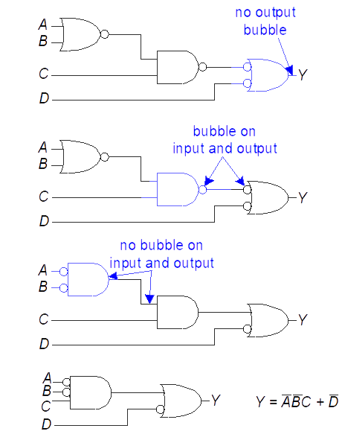
Bubble Pushing Example

Slide 34
Bubble Pushing Example

Slide 35
Bubble Pushing Example

Slide 36
BUBBLE PUSHING FOR CMOS LOGIC

Slide 37
BUBBLE PUSHING FOR CMOS LOGIC

Slide 38
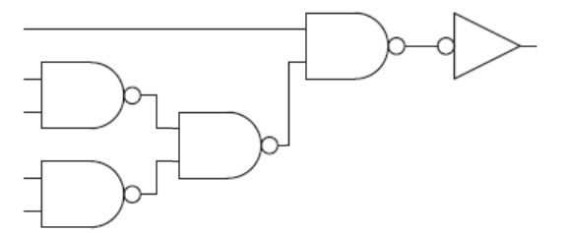
BUBBLE PUSHING FOR CMOS LOGIC

Slide 39
Completeness
NAND (and NOR) is functionally complete (universal)
NOT
AND
OR

Slide 40
Esercizi De Morgan
Y= A’BC+(BC’)’+BC
= A’BC+(B’+C)+BC
= A’BC+B’+C+BC
= B’+C

Slide 41
Esercizi De Morgan
Y= (A+B+C)’D+AD+B
= A’B’C’D+AD+B
= A’B’C’D+AD+B + A’BC’D
= A’B’C’D+AD+B + A’BC’D
= A’C’D+AD+B = A’C’D+AC’D+AD+B
= C’D+AD+B

Slide 42
Esercizi De Morgan
Y = ABCD+A’BC’D+(B’+D)’E
= ABCD+A’BC’D+BD’E

